Slide 1

Telecom Customer Retention
Rehaan Ali Mohammed

Slide 2

PROBLEM STATEMENT
Telecom companies experience customer churn when users discontinue service due to poor network performance, billing issues, or dissatisfaction. The goal of this project is to build a machine learning model that predicts which customers are likely to churn so the company can take proactive actions to retain them.
Early Identification and mitigation of risks in Telecommunication to ensure a seamless product experience for customers by preventing service interruptions. By predicting potential issues, downtimes and disruptions can be minimized, leading to more reliable network

Slide 3
Project Description
The goal is to build a machine learning–based predictive system that:
Identifies potential risks or service issues before customers experience them.
Reduces downtime and service disruptions to maintain network reliability.
Enhances customer experience through proactive risk management.
Analyzes large volumes of network and customer usage data to predict churn likelihood and trigger retention strategies.

Slide 4

WHO ARE THE END USERS?
End User | Role / Benefit
Telecom Network Operations Team | Uses predictions to detect weak network areas and reduce future outages.
Customer Experience / Support Team | Gets alerts about at-risk customers and can offer promotions or resolve complaints proactively.
Business / Marketing Teams | Creates targeted retention campaigns based on churn probability.
Data Analysts / ML Engineers | Monitor model accuracy and improve prediction pipeline.
Telecom Executives / Management | Make strategic decisions to reduce churn and improve revenue.
Customers (Indirect End Users) | Benefit from improved network reliability & better service support.

Slide 5

Technology Used
Category | Tools
Programming Language | Python
Libraries | Pandas, NumPy, Matplotlib, Seaborn, Scikit-learn, XGBoost
ML Techniques | Logistic Regression, Random Forest, Gradient Boosting, XGBoost
Model Evaluation | Accuracy, Confusion Matrix, Classification Report, ROC-AUC

Slide 6
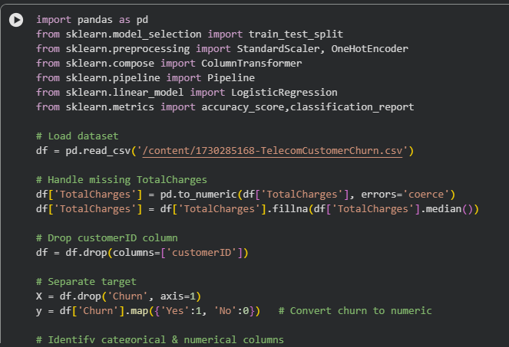
RESULTS

Slide 7
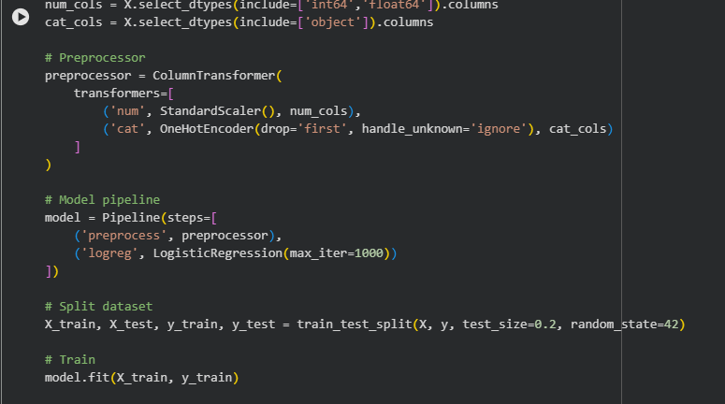
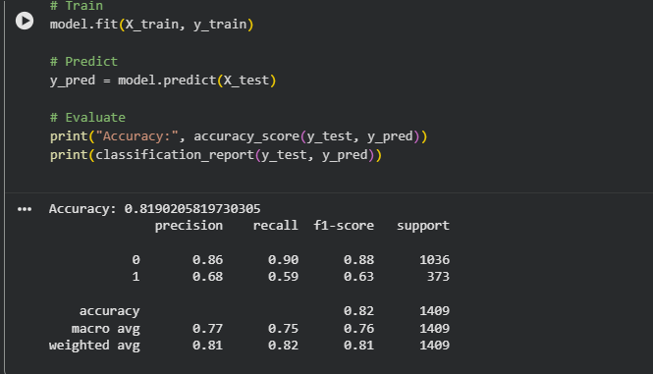

Slide 8
Thank you
Git Hub Link: https://github.com/Rehaan0745/Telecom-Cust-Retention
.
.

